Slide 1




CDAC Kharghar | Aug 25
INTERPOLATION
SEARCH
Presented by:
033_Aryan_Pate &
159_Rutuja_Gholap

Slide 2
Overview
1.
Introduction
5.
Applications
2.
Work and Example
6.
Algorithm Comparision
3.
Implementation
7.
Conclusion
4.
Advantages & Disadvantages
8.
Reference

Slide 3

INTERPOLATION SEARCH
A Smart Searching Algorithm for Uniformly Distributed Data
An Advanced Alternative to Binary Search
📊

Slide 4
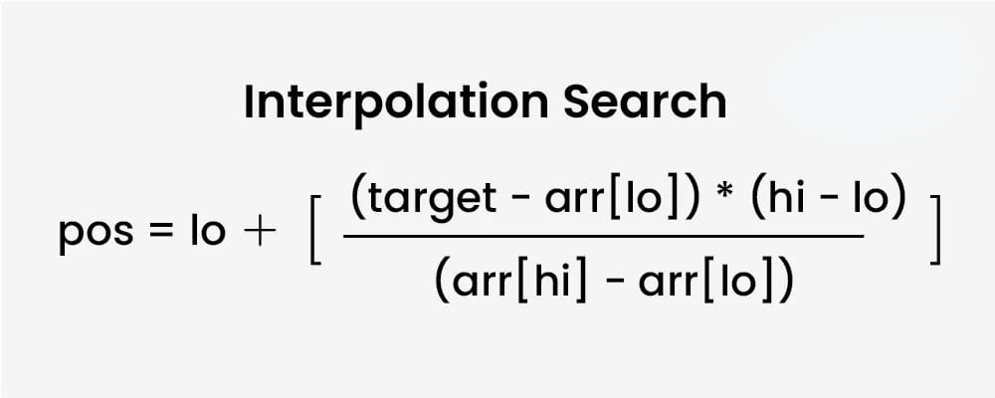
What is Interpolation Search?
  An improved variant of Binary Search that works on sorted arrays
  Instead of checking the middle element, it estimates the probable position
  Uses interpolation formula to predict where the target value might be located
  Assumes elements are uniformly distributed

Slide 5
Why Interpolation Search? 🤔
  Binary Search Limitation: Always checks middle element regardless of target value
  Real-world Analogy: When looking for "Wilson" in phone book, you don't start from "M"
  Mathematical Insight: If data is uniformly distributed, we can predict better positions
  Performance Goal: Reduce average search time from O(log n) to O(log log n)
E xample: Searching for 750 in range [100, 1000]
Binary: Checks 550 (middle)
Interpolation: Estimates around 750 directly!

Slide 6
How It Works 🛠️
Step-by-Step Process:
Step 1: Calculate estimated position using interpolation formula
Step 2: Compare target with element at estimated position
Step 3: If match found → return position
Step 4: If target is smaller → search left subarray
Step 5: If target is larger → search right subarray
Step 6: Repeat until found or search space exhausted
Position Calculation:
pos = low + ((key - arr[low]) × (high - low) / (arr[high] - arr[low]))

Slide 7
Example Walkthrough 📝
Array: [1, 3, 7, 15, 20, 21, 50, 55, 75, 80]
Target/ key = 50
[1] [3] [7] [15] [20] [21] [50] [55] [75] [80] | [Elements]
0 1 2 3 4 5 6 7 8 9 | [Index]
Iteration 1:
low = 0, high = 9
pos = 0 + ((50-1) × (9-0)) / (80-1)
pos = 0 + (49 × 9) / 79 = 5.58 ≈ 5
arr[5] = 21 < 50, so low = 6
Iteration 2:
low = 6, high = 9
pos = 6 + ((50-50) × (9-6)) / (80-50)
pos = 6 + (0 × 3) / 30 = 6
arr[6] = 50 ✅ FOUND!

Slide 8
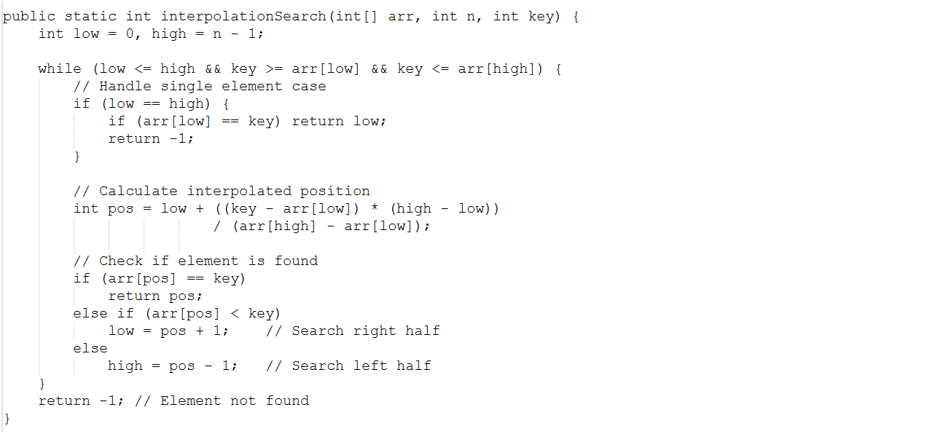
Code Implementation 💻

Slide 9
Advantages
  Performance Benefits:
Faster than Binary Search: O(log log n) for uniform data
Fewer Comparisons: Makes intelligent guesses
Efficient for Large Datasets: Significant improvement with big arrays
  Smart Features:
Value-Based Search: Uses actual data values for estimation
Adaptive Algorithm: Adjusts based on data distribution
Intuitive Approach: Mimics human search behavior
  Comparison:
Binary Search: 1000 elements → ~10 comparisons
Interpolation Search: 1000 elements → ~3-4 comparisons

Slide 10
Disadvantages
  Limitations:
Uniform Distribution Required: Poor performance on skewed data
Additional Computation: Formula calculation overhead
Integer Overflow Risk: Large values can cause overflow
  Specific Conditions:
Sorted Array Only: Requires pre-sorted data
Numerical Data: Works best with numbers
Memory Access Pattern: May not be cache-friendly
  Worst Case Example:
Array: [1, 2, 3, 4, 100000] - searching for 100000
Interpolation may perform worse than binary search due to poor distribution!

Slide 11
Real-World Applications 🌍
  Database Systems:
Index searching in sorted database tables
Timestamp-based log searches
  Financial Systems:
Stock price lookups
Time series data analysis
  Classic Example: Phone Directory 📞
When searching for "Smith" in a phone book:
• You don't start from the middle (around "M")
• You estimate "Smith" is around 75% through the book
• This is exactly how interpolation search works!

Slide 12
When to Use Interpolation Search?
Use When:
Data is uniformly distributed
Large sorted arrays(>1000 elements)
Numerical data with predictable patterns
Performance is critical
Search operations are frequent
Avoid When:
Data is highly skewed
Small arrays(<100 elements)
String or complex data types
Memory is limited
Data changes frequently
Decision Formula:
If (data_size > 1000 && uniform_distribution && numerical_data)
→ Use Interpolation Search
Else
→ Use Binary Search

Slide 13
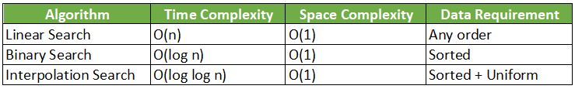
Algorithm Comparison 📊

Slide 14
Conclusion 🎯
  Interpolation Search is a smart upgrade to Binary Search
  Best suited for large, uniformly distributed datasets
  Can achieve O(log log n) time complexity
  Choose algorithm based on data characteristics
"The right algorithm for the right data leads to the right performance!"

Slide 15
Reference
GeeksforGeeks – Interpolation Search
A detailed explanation of Interpolation Search with examples and code implementation in multiple languages
Wikipedia – Interpolation Search
General overview of Interpolation Search including working principle, complexity, and theoretical background.
YouTube – Interpolation Search Tutorial
Brief Description: A video tutorial explaining Interpolation Search step-by-step with visuals and practical examples.

Slide 16
THANK YOU..!
Any Question?

